Slide 1
Data Construction
Raw Retriever
Reinforcement
Learning
Reward
Generator
Filter
Code Repos
Code Repos
Insert
Retriever
Generate
Candidates
Dependency
Analysis
Guide
Code snippet
Stop Signal
Retrieve
Candidates
Code Clusters
Generate
Concat
Split
Mask
N x
Candidate Library
Target
Code
Code snippet
Target Code

Slide 2









Parse
…
Github Repos
Code Candidates
Generator
Reward Function
Update
Retriever
Incomplete Code

Slide 3


Incomplete Code
⬥
…
◆
❖



Repository
Candidates
Retriever
Samples
Generator
Reward Function

Update

Slide 4
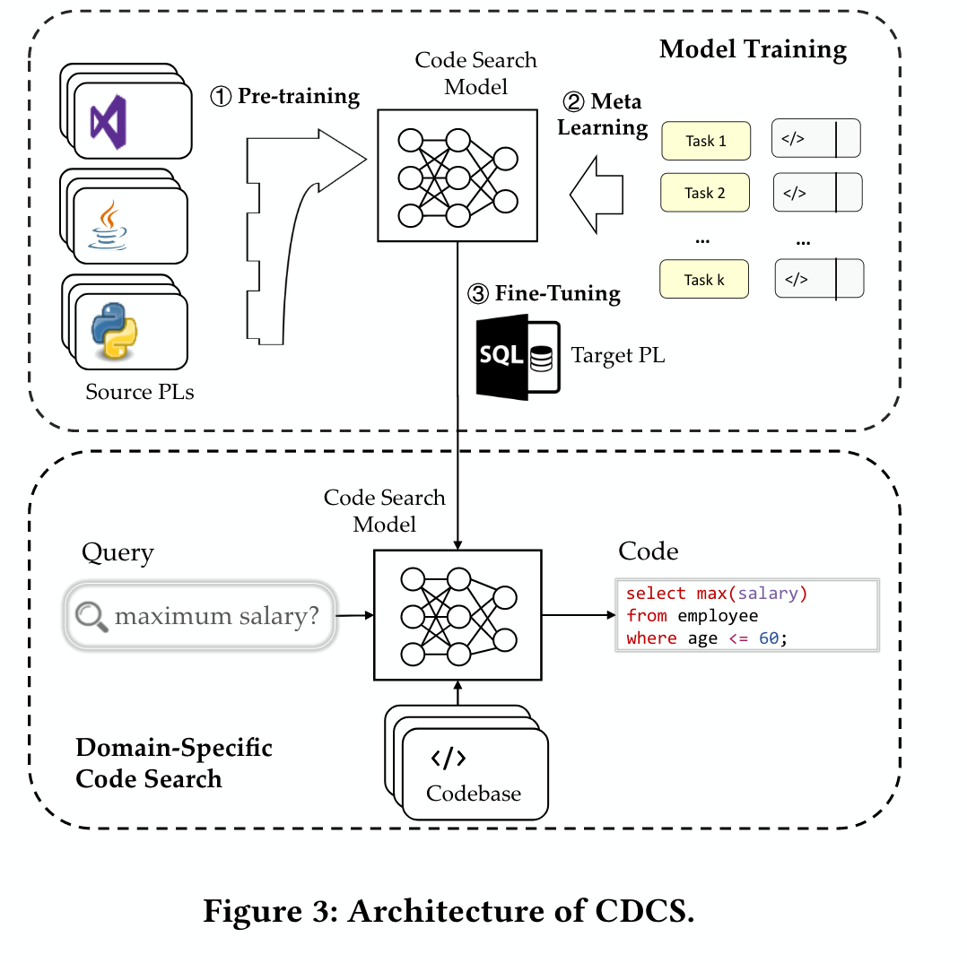




















Training
Unfinished Code
Training Data Construction
...
GitHub Repos
</>
Retrived Codes
Evaluator
RLRetriever
Codebase
$f(x)$ Reward
Testing
Unfinished Code
...
Current Repo
Testing Data Construction
Retrived Codes
</>
RLRetriever
Generator
Codebase
Codebase
Parse
</>
Codebase
Github Repos

Slide 5

Training
Target Code
Unfinished Code
...
GitHub
Repos
Retrived Codes
</>
RLRetriever
Evaluator
Codebase
$f(x)$ Reward
Inference
Unfinished Code
...
Current Repo
</>
Retrived Codes
Generator
RLRetriever
Codebase

Slide 6

Training
Target Code
Unfinished Code
...
GitHub
Repos
Retrived Codes
</>
RLRetriever
Evaluator
Codebase
$f(x)$ Weighted Perplexity Reward
Inference
Unfinished Code
...
Current Repo
</>
Retrived Codes
Generator
RLRetriever
Codebase

Slide 7

Target Code
GitHub
Repos
Unfinished Code
...
</>
Retrived Codes
Evaluator
Training
RLRetriever
Codebase
$f(x)$ Weighted Perplexity Reward
Inference
Unfinished Code
...
Current Repo
</>
Retrived Codes
Generator
RLRetriever
Codebase

Slide 8
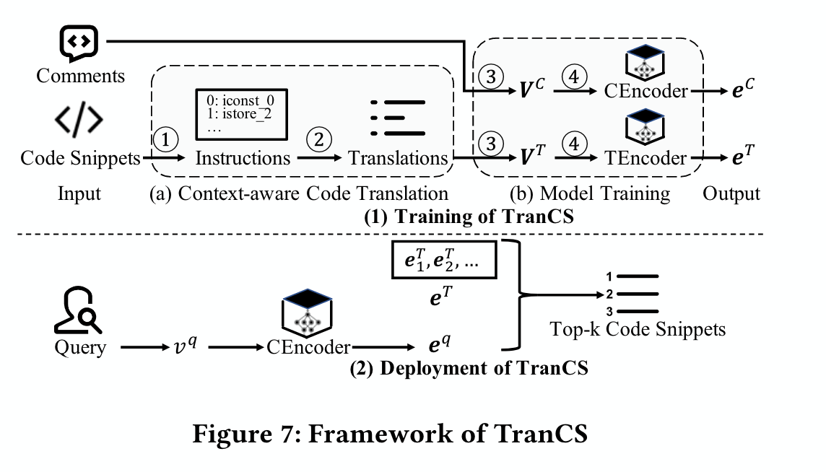
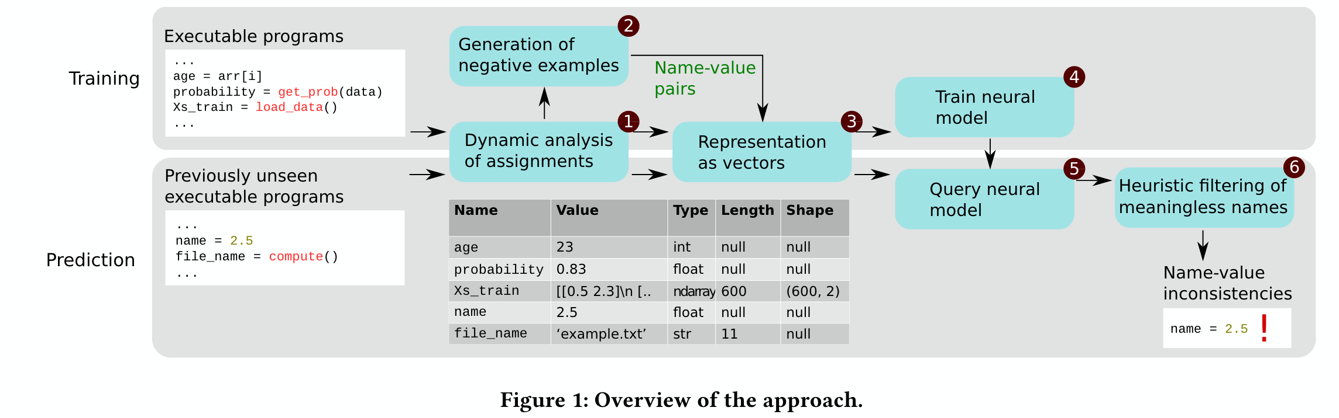

Slide 9





⬥
Mask
❖
◆
Dependency
Analysis
Target Code
Filter

Split
Code Repositories
Code Clusters
Candidates

Slide 10
# zope/interface/tests/test_ro.py
"""Resolution ordering utility tests"""
import unittest
# pylint:disable=blacklisted-name,protected-access,attribute-defined-outside-init
class Test__mergeOrderings(unittest.TestCase):
def _callFUT(self, orderings):
from zope.interface.ro import _legacy_mergeOrderings
return _legacy_mergeOrderings(orderings)
def test_empty(self):
self.assertEqual(self._callFUT([]), []) ...
Retrieved Context
def _legacy_mergeOrderings(orderings):
"""Merge multiple orderings so that within-ordering order is preserved
Orderings are constrained in such a way that if an object appears
in two or more orderings, then the suffix that begins with the object
must be in both orderings.
...
"""
Problem Head
result = []
for ordering in orderings:
result.extend(ordering)
result.sort()
return result
Generation with Retrieval
seen = set()
result = []
for ordering in reversed(orderings):
for o in reversed(ordering):
if o not in seen:
seen.add(o)
result.insert(0, o)
return result
Generation without Retrieval

Slide 11
Candidate 1
class Converter(object):
"""
The :class:`.Converter` class is the base class for implementing the
conversion from one in-style parameter to another out-style parameter.
"""
def __init__(
self,
escape_char: Optional[str],
expand_tuples: bool,
Candidate 2
in_regex: Pattern[str],
in_style: _styles.Style,
out_style: _styles.Style,
) -> None:
"""
Initializes the :class:`.Converter` instance.
"""
self._escape_start = len(escape_char) if escape_char is not None else 0
"""
Code Continuity is Disrupted!
*_escape_start* (:class:`int`) is the offset used to
skip the escape character.
"""
self._expand_tuples: bool = expand_tuples
"""
*_expand_tuples* (:class:`bool`) is whether to convert tuples into a
sequence of parameters.
"""
Candidate 3

Slide 12
Candidate 1
class Converter(object):
"""
The :class:`.Converter` class is the base class for implementing the
conversion from one in-style parameter to another out-style parameter.
"""
def __init__(
self,
escape_char: Optional[str],
expand_tuples: bool,
Candidate 2
in_regex: Pattern[str],
in_style: _styles.Style,
out_style: _styles.Style,
) -> None:
"""
Initializes the :class:`.Converter` instance.
"""
self._escape_start = len(escape_char) if escape_char is not None else 0
"""
Code Continuity is Disrupted!
*_escape_start* (:class:`int`) is the offset used to
skip the escape character.
"""
self._expand_tuples: bool = expand_tuples
"""
*_expand_tuples* (:class:`bool`) is whether to convert tuples into a
sequence of parameters.
"""
Candidate 3

Slide 13
class Converter(object):
"""
The :class:`.Converter` class is the base class for implementing the
conversion from one in-style parameter to another out-style parameter.
"""
def __init__(
self,
escape_char: Optional[str],
expand_tuples: bool,
in_regex: Pattern[str],
in_style: _styles.Style,
out_style: _styles.Style,
) -> None:
"""
Initializes the :class:`.Converter` instance.
"""
self._escape_start = len(escape_char) if escape_char is not None else 0
"""
*_escape_start* (:class:`int`) is the offset used to skip the escape
character.
"""
self._expand_tuples: bool = expand_tuples
"""
*_expand_tuples* (:class:`bool`) is whether to convert tuples into a
sequence of parameters.
"""
class Converter(object):
"""
The :class:`.Converter` class is the base class for implementing the
conversion from one in-style parameter to another out-style parameter.
"""
class Converter(object):
"""
The :class:`.Converter` class is the base class for implementing the
conversion from one in-style parameter to another out-style parameter.
"""
Candidate 1
def __init__(
self,
escape_char: Optional[str],
expand_tuples: bool,
in_regex: Pattern[str],
in_style: _styles.Style,
out_style: _styles.Style,
) -> None:
"""
Initializes the :class:`.Converter` instance.
"""
def __init__(
self,
escape_char: Optional[str],
expand_tuples: bool,
in_regex: Pattern[str],
in_style: _styles.Style,
out_style: _styles.Style,
) -> None:
"""
Initializes the :class:`.Converter` instance.
"""
Split
Aggregate
Candidate 2
self._escape_start = len(escape_char) if escape_char is not None else 0
"""
*_escape_start* (:class:`int`) is the offset used to skip the escape
character.
"""
self._escape_start = len(escape_char) if escape_char is not None else 0
"""
*_escape_start* (:class:`int`) is the offset used to skip the escape
character.
""“
self._expand_tuples: bool = expand_tuples
"""
*_expand_tuples* (:class:`bool`) is whether to convert tuples into a
sequence of parameters.
"""
self._expand_tuples: bool = expand_tuples
"""
*_expand_tuples* (:class:`bool`) is whether to convert tuples into a
sequence of parameters.
"""
Candidate 3

Slide 14
Raw Code
Mini Blocks
Candidates
class Converter(object):
"""
The :class:`.Converter` class is the base class for
implementing the conversion from one in-style
parameter to another out-style parameter.
"""
def __init__(
self,
escape_char: Optional[str],
expand_tuples: bool,
in_regex: Pattern[str],
in_style: _styles.Style,
out_style: _styles.Style,
) -> None:
"""
Initializes the :class:`.Converter` instance.
"""
self._escape_start = len(escape_char)
if escape_char is not None else 0
"""
*_escape_start* (:class:`int`) is the offse
used to skip the escape character.
"""
self._expand_tuples: bool = expand_tuples
"""
*_expand_tuples* (:class:`bool`) is whether to
convert tuples into a sequence of parameters.
"""
class Converter(object):
"""
The :class:`.Converter` class is the base class for
implementing the conversion from one in-style
parameter to another out-style parameter.
"""
class Converter(object):
"""
The :class:`.Converter` class is the base class for
implementing the conversion from one in-style
parameter to another out-style parameter.
"""
def __init__(
self,
escape_char: Optional[str],
expand_tuples: bool,
in_regex: Pattern[str],
in_style: _styles.Style,
out_style: _styles.Style,
) -> None:
"""
Initializes the :class:`.Converter` instance.
"""
def __init__(
self,
escape_char: Optional[str],
expand_tuples: bool,
in_regex: Pattern[str],
in_style: _styles.Style,
out_style: _styles.Style,
) -> None:
"""
Initializes the :class:`.Converter` instance.
"""
Split
Aggregate
self._escape_start = len(escape_char)
if escape_char is not None else 0
"""
*_escape_start* (:class:`int`) is the offse
used to skip the escape character.
"""
self._escape_start = len(escape_char)
if escape_char is not None else 0
"""
*_escape_start* (:class:`int`) is the offse
used to skip the escape character.
"""
self._expand_tuples: bool = expand_tuples
"""
*_expand_tuples* (:class:`bool`) is whether to
convert tuples into a sequence of parameters.
"""
self._expand_tuples: bool = expand_tuples
"""
*_expand_tuples* (:class:`bool`) is whether to
convert tuples into a sequence of parameters.
"""

Slide 15
Raw Code
Mini Blocks
Candidates
class Converter(object):
"""
The :class:`.Converter` class is the base class for
implementing the conversion from one in-style
parameter to another out-style parameter.
"""
Candidates
class Converter(object):
"""
The :class:`.Converter` class is the base class for
implementing the conversion from one in-style
parameter to another out-style parameter.
"""
def __init__(
self,
escape_char: Optional[str],
expand_tuples: bool,
in_regex: Pattern[str],
in_style: _styles.Style,
out_style: _styles.Style,
) -> None:
"""
Initializes the :class:`.Converter` instance.
"""
self._escape_start = len(escape_char)
if escape_char is not None else 0
"""
*_escape_start* (:class:`int`) is the offse
used to skip the escape character.
"""
self._expand_tuples: bool = expand_tuples
"""
*_expand_tuples* (:class:`bool`) is whether to
convert tuples into a sequence of parameters.
"""
class Converter(object):
"""
The :class:`.Converter` class is the base class for
implementing the conversion from one in-style
parameter to another out-style parameter.
"""
def __init__(
self,
escape_char: Optional[str],
expand_tuples: bool,
in_regex: Pattern[str],
in_style: _styles.Style,
out_style: _styles.Style,
) -> None:
"""
Initializes the :class:`.Converter` instance.
"""
def __init__(
self,
escape_char: Optional[str],
expand_tuples: bool,
in_regex: Pattern[str],
in_style: _styles.Style,
out_style: _styles.Style,
) -> None:
"""
Initializes the :class:`.Converter` instance.
"""
Split
Aggregate
self._escape_start = len(escape_char)
if escape_char is not None else 0
"""
*_escape_start* (:class:`int`) is the offse
used to skip the escape character.
"""
self._escape_start = len(escape_char)
if escape_char is not None else 0
"""
*_escape_start* (:class:`int`) is the offse
used to skip the escape character.
"""
self._expand_tuples: bool = expand_tuples
"""
*_expand_tuples* (:class:`bool`) is whether to
convert tuples into a sequence of parameters.
"""
self._expand_tuples: bool = expand_tuples
"""
*_expand_tuples* (:class:`bool`) is whether to
convert tuples into a sequence of parameters.
"""

Slide 16
# sqlparams/__init__.py
def formatmany(self, sql: TSqlStr,
many_params: Union[Iterable[Dict[Union[str, int], Any]], Iterable[Sequence[Any]]],
) -> Tuple[TSqlStr, Union[List[Dict[str, Any]], List[Sequence[Any]]]]:
"""
Convert the SQL query to use the out-style parameters instead of the in-style parameters.
...
"""
# Normalize query encoding to simplify processing.
if isinstance(sql, str):
use_sql = sql
string_type = str
elif isinstance(sql, bytes):
# sqlparams/_util.py
def is_iterable(value):
"""
Check whether the value is an iterable (excludes strings).
*value* is the value to check,
Returns whether *value* is a iterable (:class:`bool`).
"""
return isinstance(value, Iterable) and not isinstance(value, (str, bytes))
use_sql = sql.decode(_BYTES_ENCODING)
string_type = bytes
else:
raise TypeError(f"{sql=!r} is not a unicode or byte string.")
# sqlparams/__init__.py
def __strip_comments_from_sql(self, sql: str) -> str:
"""
Strip comments from the SQL.
*sql* (:class:`str`) is the SQL query.
Returns the stripped SQL query (:class:`str`).
"""
out_sql = sql
for comment_regex in self.__strip_comment_regexes:
out_sql = comment_regex.sub("", out_sql)
return out_sql
if not _util.is_iterable(many_params):
raise TypeError(f"{many_params=!r} is not iterable.")
# Strip comments.
use_sql = self.__strip_comments_from_sql(use_sql)
# Replace in-style with out-style parameters.
use_sql, many_out_params = self.__converter.convert_many(use_sql, many_params)
# Make sure the query is returned as the proper string type.
if string_type is bytes:
out_sql = use_sql.encode(_BYTES_ENCODING)
else:
out_sql = use_sql
# Return converted SQL and out-parameters.
return out_sql, many_out_params
# sqlparams/_converting.py
def convert_many(self, sql: str,
many_params: Union[Iterable[Dict[Union[str, int], Any]], Iterable[Sequence[Any]]],
) -> Tuple[str, Union[List[Dict[Union[str, int], Any]], List[Sequence[Any]]]]:
"""
Convert the SQL query to use the named out-style parameters from the named
the in-style parameters.
*sql* (:class:`str`) is the SQL query.
*many_params* (:class:`~collections.abc.Iterable`) contains each set of
in-style parameters (:class:`~collections.abc.Mapping` or :class:`~collections.abc.Sequence`).
Returns a :class:`tuple` containing: the converted SQL query (:class:`str`),
and the many out-style parameters (:class:`list` of :class:`dict` or
:class:`list`).
"""
raise NotImplementedError(f"{self.__class__.__qualname__} must implement convert_many().")
# sqlparams/__init__.py
_BYTES_ENCODING = 'latin1'

Slide 17
...
if not _util.is_iterable(many_params):
raise TypeError(f"{many_params=!r} is not iterable.")
# Strip comments.
use_sql = self.__strip_comments_from_sql(use_sql)
# Replace in-style with out-style parameters.
use_sql, many_out_params = self.__converter.convert_many(use_sql, many_params)
# Make sure the query is returned as the proper string type.
if string_type is bytes:
out_sql = use_sql.encode(_BYTES_ENCODING)
else:
out_sql = use_sql
# Return converted SQL and out-parameters.
return out_sql, many_out_params
...
...
if not _util.is_iterable(many_params):
raise TypeError(f"{many_params=!r} is not iterable.")
# Strip comments.
use_sql = self.__strip_comments_from_sql(use_sql)
# Replace in-style with out-style parameters.
use_sql, many_out_params = self.__converter.convert_many(use_sql, many_params)
# Make sure the query is returned as the proper string type.
if string_type is bytes:
out_sql = use_sql.encode(_BYTES_ENCODING)
else:
out_sql = use_sql
# Return converted SQL and out-parameters.
return out_sql, many_out_params
...
...
if not _util.is_iterable(many_params):
raise TypeError(f"{many_params=!r} is not iterable.")
# Strip comments.
use_sql = self.__strip_comments_from_sql(use_sql)
# Replace in-style with out-style parameters.
use_sql, many_out_params = self.__converter.convert_many(use_sql, many_params)
# Make sure the query is returned as the proper string type.
if string_type is bytes:
out_sql = use_sql.encode(_BYTES_ENCODING)
else:
out_sql = use_sql
# Return converted SQL and out-parameters.
return out_sql, many_out_params
...
Mask

Slide 18
Data Construction
Raw Retriever
Reward
Reinforcement
Learning
Generator
Filter
Code Repos
Code Repos
Insert
Generate
Retriever
Dependency
Analysis
Candidates
Guide
Code snippet
Stop Signal
Retrieve
Candidates
Code Clusters
Concat
Generate
Split
Mask
N x
Candidate Library
Target
Code
Code snippet
Target Code

Slide 19
Problem Head
Weighted Token
…
…
…
Retrieved Blocks
Generated Code

Slide 20
Stop Signal
Reserve
Discard
…
…
Top-k Candidates

Slide 21
Code
Blocks
Unfinished
Code
Code
Blocks
Unfinished
Code
Code
Blocks
Unfinished
Code
Retrieval
Retrieval
Retrieval
Generation
Generation
Generation
Retrieval
Retrieval
N x
N x
Prediction
Generation
Generation
Prediction
Prediction
Iterative Generation
Forward Generation
Hybrid Forward-Iterative Generation

